Slide 1

MECHATRONİC COMPONENTS PHYSİCAL PROJECT PRESENTATİON
Lecturer:
Prof. Dr. Ali Bülent Uşaklı
Learner:
Mustafa Usta
200313004

Slide 2
Table of contents
01
04
02
05
03
06
Project Purposal
Project İmages
Parts used in Proj.
Project drawings and mechanichal tests
Project Annotations
Project Presentation

Slide 3
Project Proposal
The primary purpose of the project; sensors, actuators; The digital, analog parts and power electronics components that we see in the mechatronic components course work in harmony with each other in a mechanical, electrical and software project.

Slide 4
List of parts used in the project
Servo Motor x4
Arduino Mega x1
Power card x1
Joystick x2
Plexiglass Robotic Arm Kit x1

Slide 5
Project Annotations
Robot Material: Plexiglass
(LightWeight, Cheap,accessible)
Dimensions: 15x10x15 cm

Slide 6
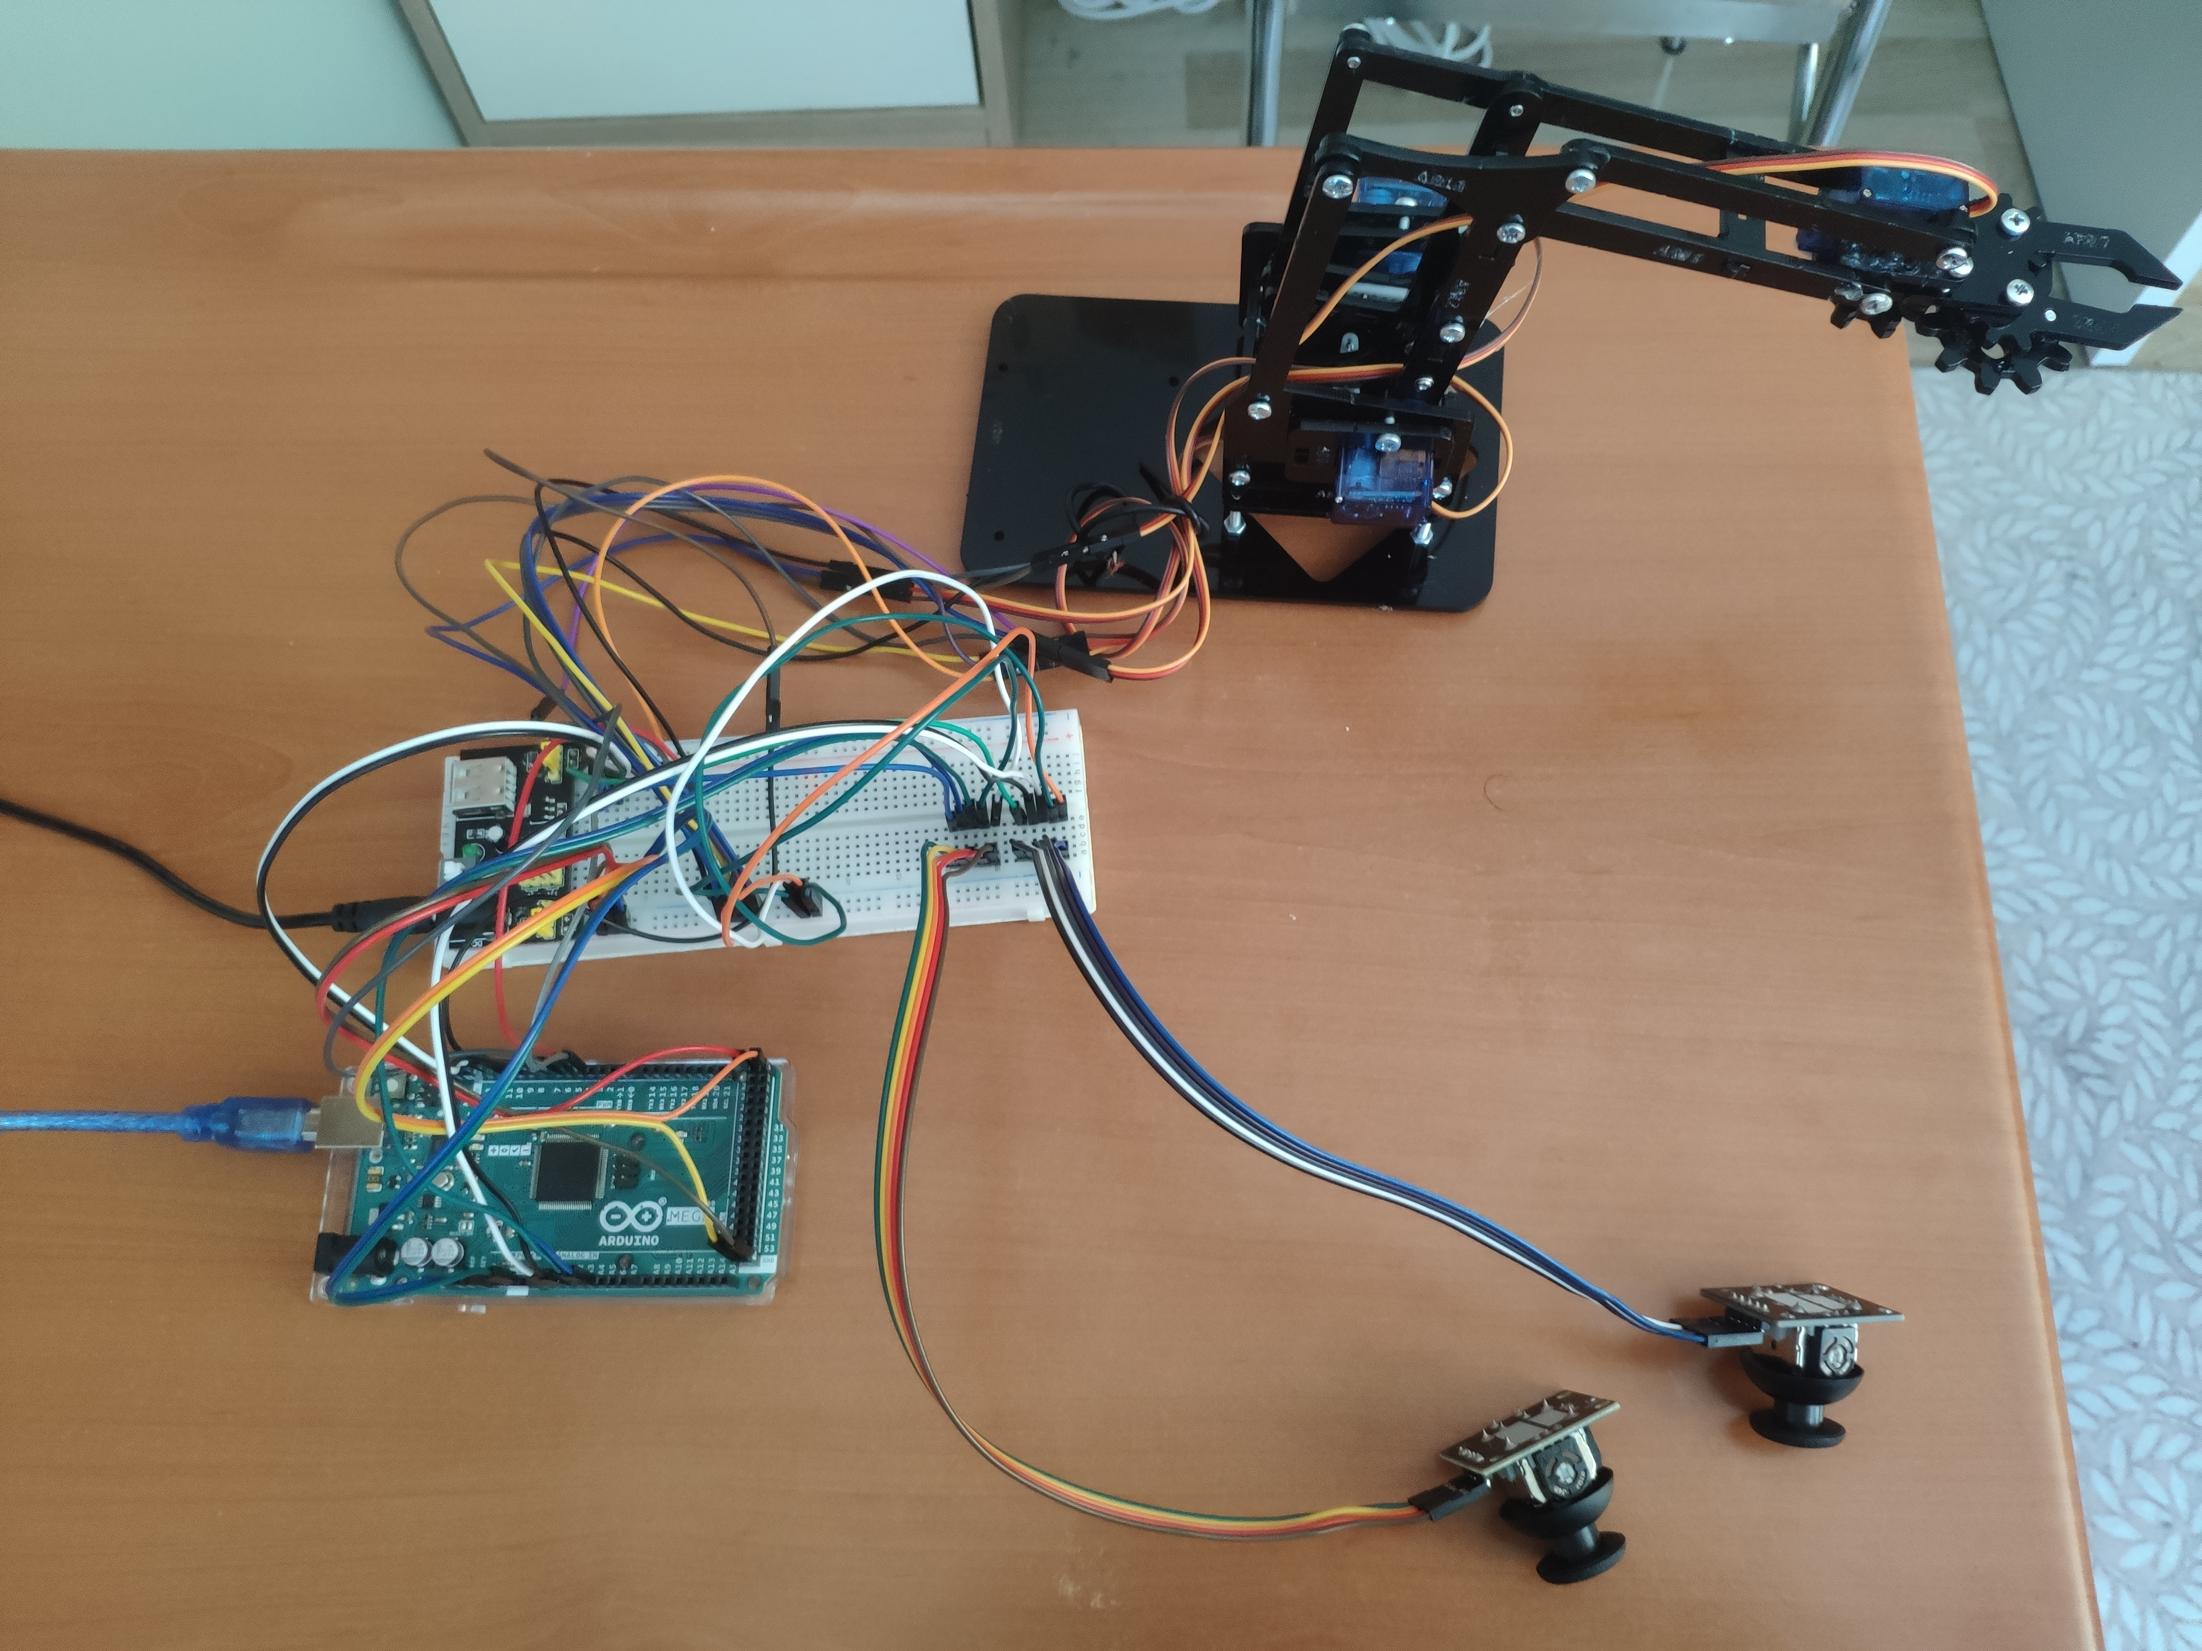
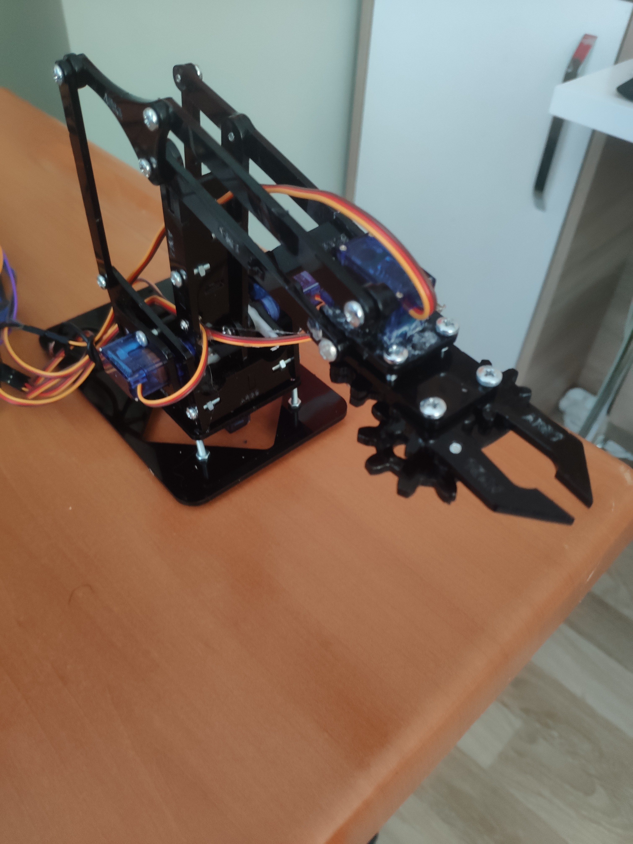
Project Images

Slide 7
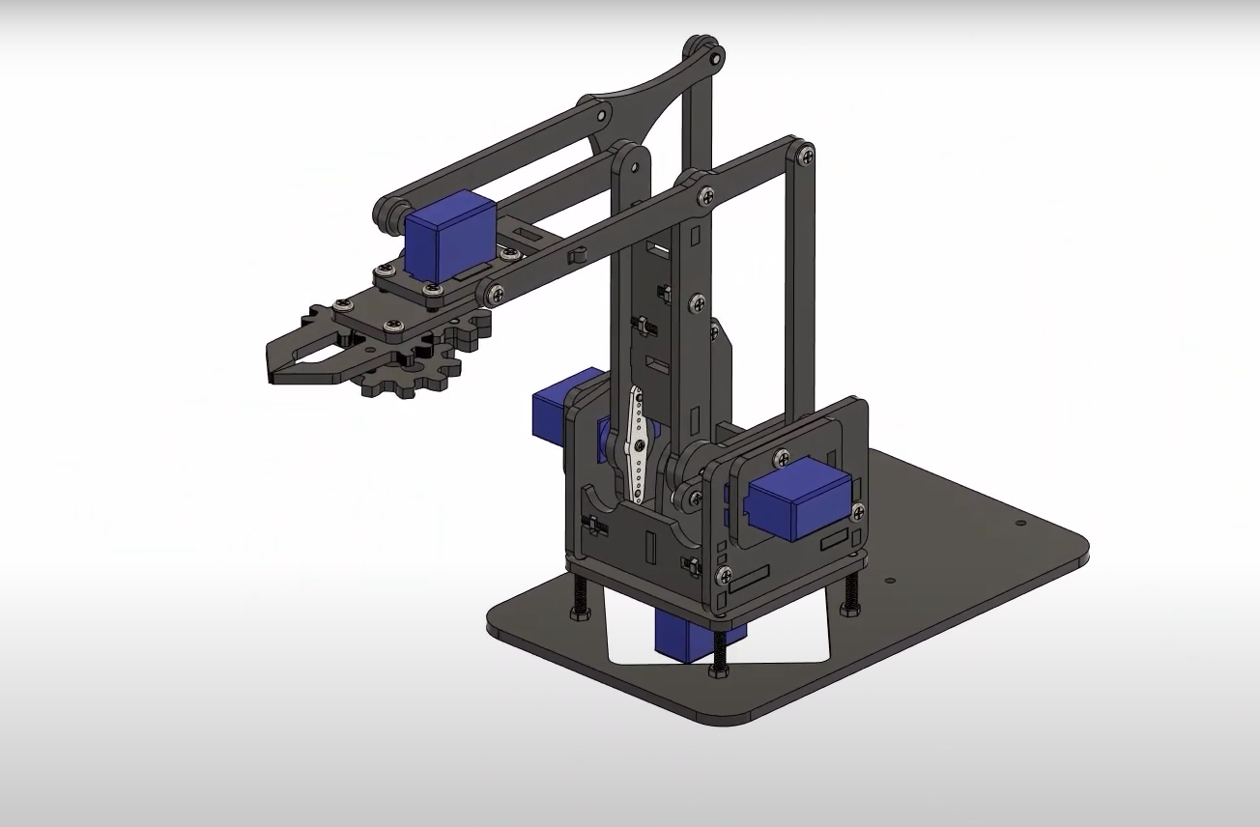
Project Drawing in Solidworks

Slide 8
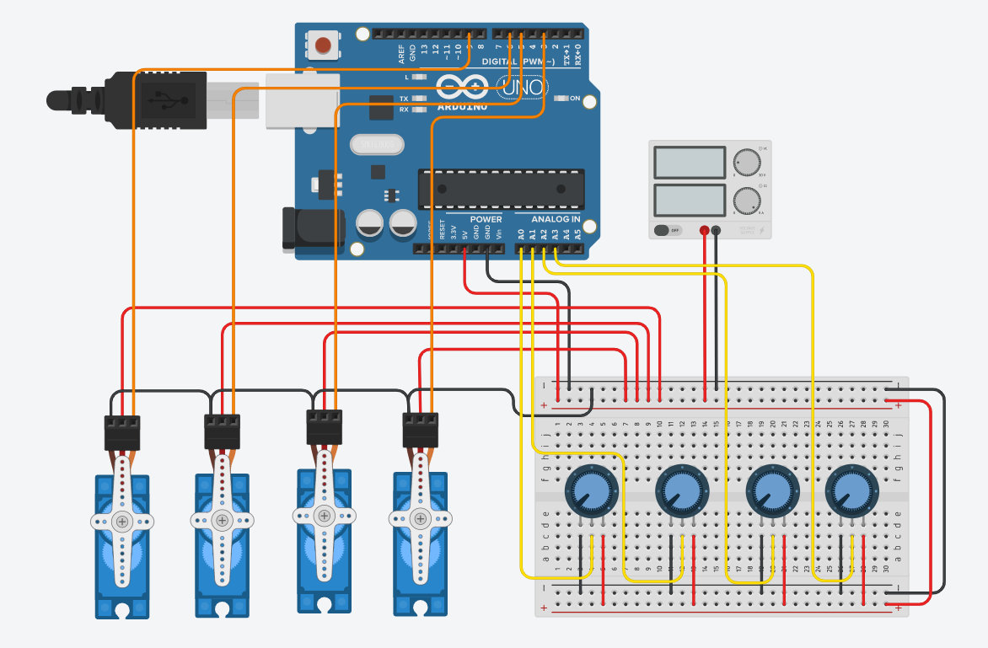
Electricitial Drawing

Slide 9
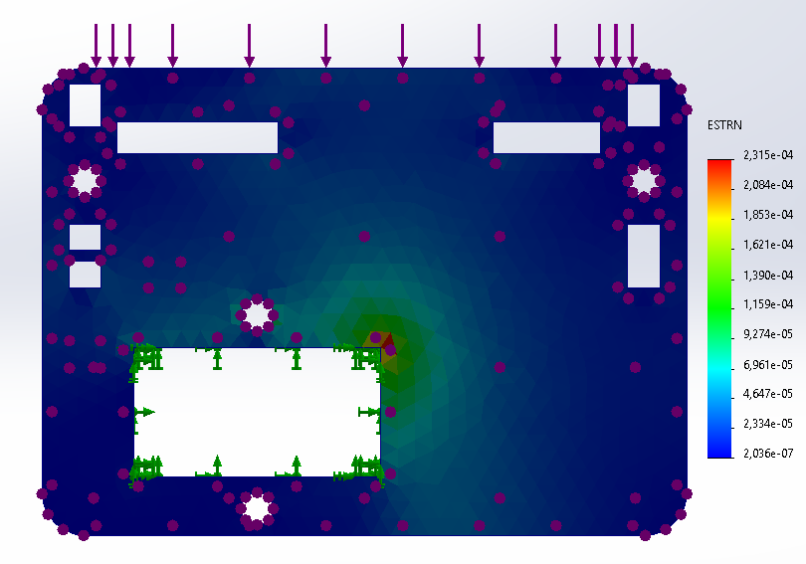
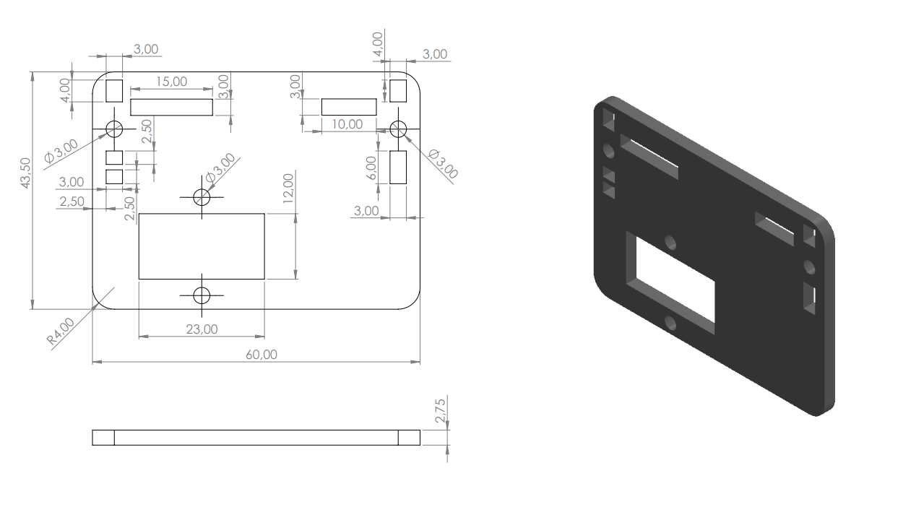
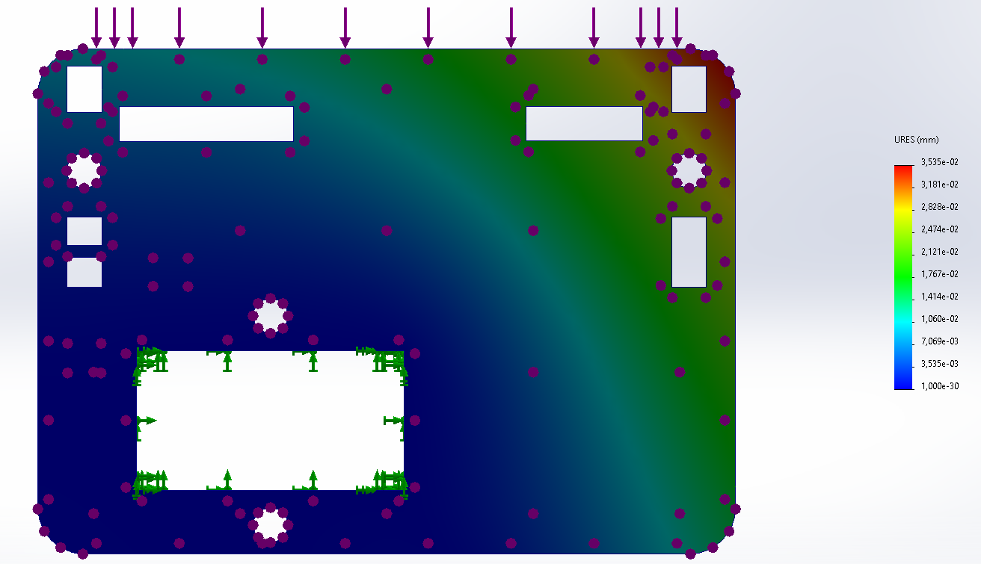
Technical drawing and Mechanical tests
Displacement
analysis
Technical Drawing
Stress
Analysis

Slide 10
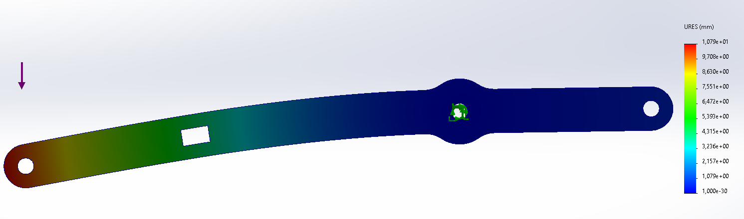
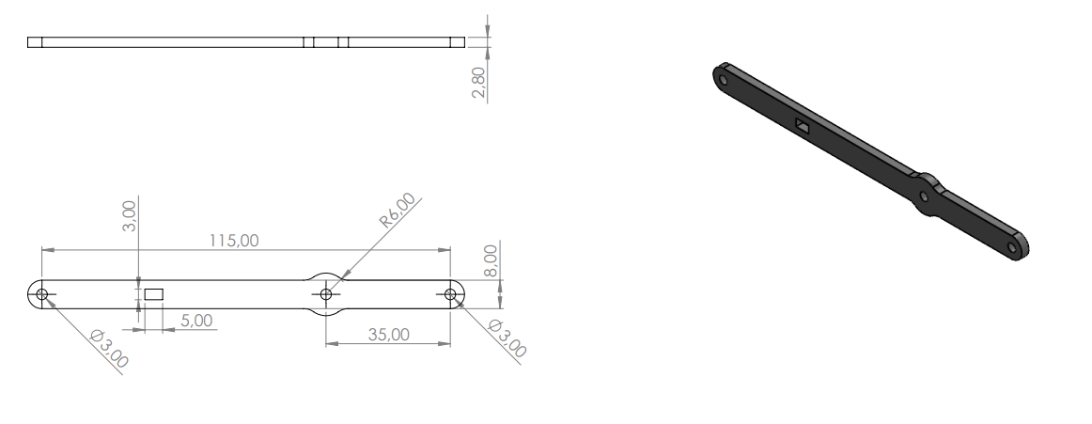
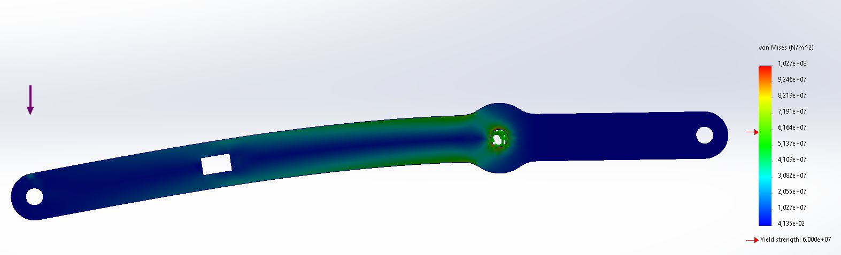
Technical drawing and Mechanical tests
Displacement Analysis
Technical Drawing
Stress Analysis

Slide 11
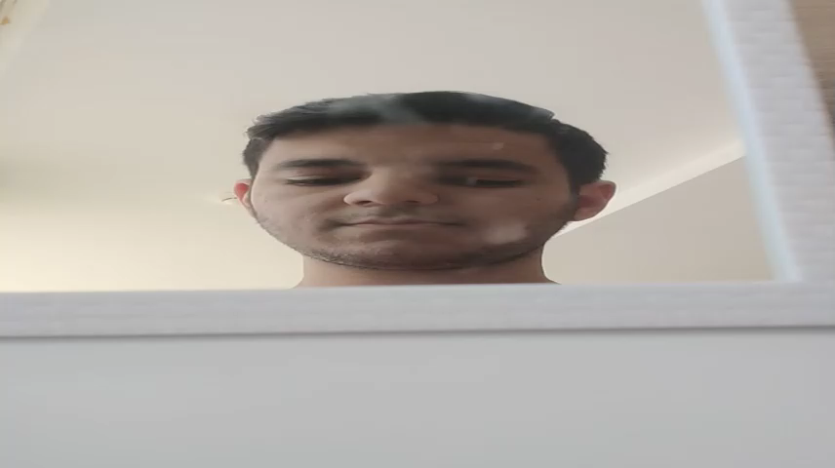
Project Presentation

Slide 12
Thanks
Mustafa Usta

